Slide 1

Infosys Internship
Image Based Recommendation System: Leveraging Pre-Trained Models
Presented by:
Sushanth Kothari
Varsha Peddireddy
Vaithees
Lakshmi Prasanna
Guided By
Mr. Anil Shaw

Slide 2
Introduction: Overview of the Project and its Purpose
Overview of AI in Fashion:
Importance of Recommendation Systems in the Industry:
AI technologies like machine learning, deep learning, and natural language processing are transforming the fashion industry by enabling personalized experiences. Recommender systems in fashion e-commerce predict user preferences, enhancing user experience and boosting sales.
Recommender systems use collaborative filtering (user-item interactions) and content-based filtering (item features) to make personalized predictions. Hybrid models, which combine both methods, offer more accurate recommendations by leveraging user interaction data and item metadata.

Slide 3
Implementation: Steps Followed for Building the System
Step 1: Data Collection and Preprocessing: Gather a diverse dataset of clothing images and associated metadata.
1
2
Step 2: Pre-trained Model Selection: Choose a suitable pre-trained model, like VGG16, MobileNet, or ResNet, for image feature extraction.
Step 3: Feature Extraction: Process images through the selected model to generate image embeddings, representing visual features.
3
4
Step 4: Similarity Calculation: Compute cosine similarity between image embeddings to measure the similarity between outfits.
Step 5: Recommendation Generation: Rank potential outfit combinations based on similarity and present the top recommendations.
5

Slide 4



Computing Cosine Similarity on Image Embeddings
Image Embeddings
1
Representations of visual features of an outfit, generated by the pre-trained model.
Cosine Similarity
2
A metric to measure the angle between two image embeddings, indicating how similar the outfits are.
Recommendation
3
Generate outfit recommendations based on cosine similarity scores, presenting similar outfits to the user's preferences.

Slide 5
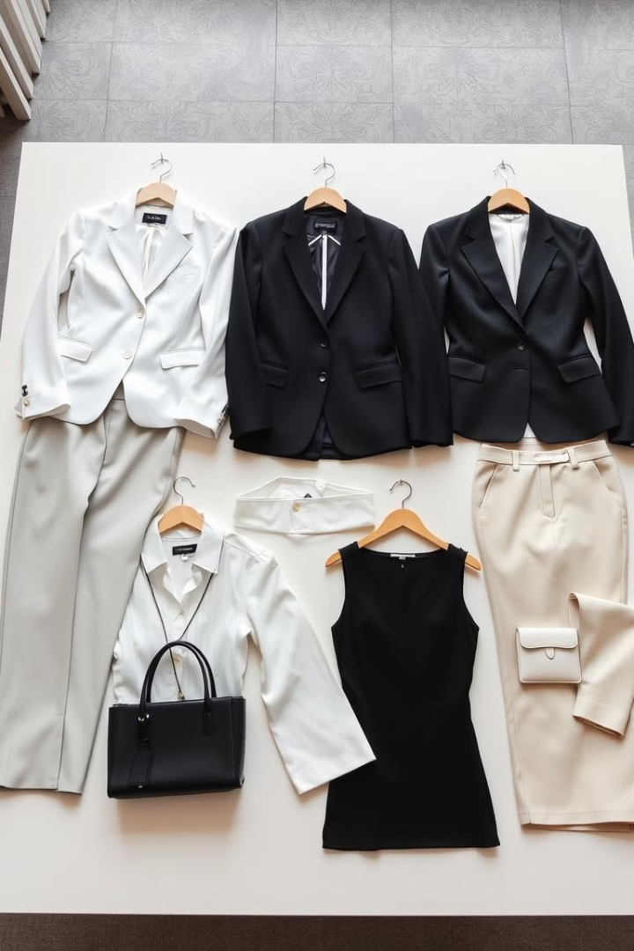
Methodology: Pre-trained Models Used
VGG16
MobileNet
A deep convolutional neural network known for its powerful image classification abilities.
A lightweight model optimized for mobile devices, offering fast and efficient image processing.
ResNet
A powerful model using residual connections to improve training performance and handle deeper networks.

Slide 6
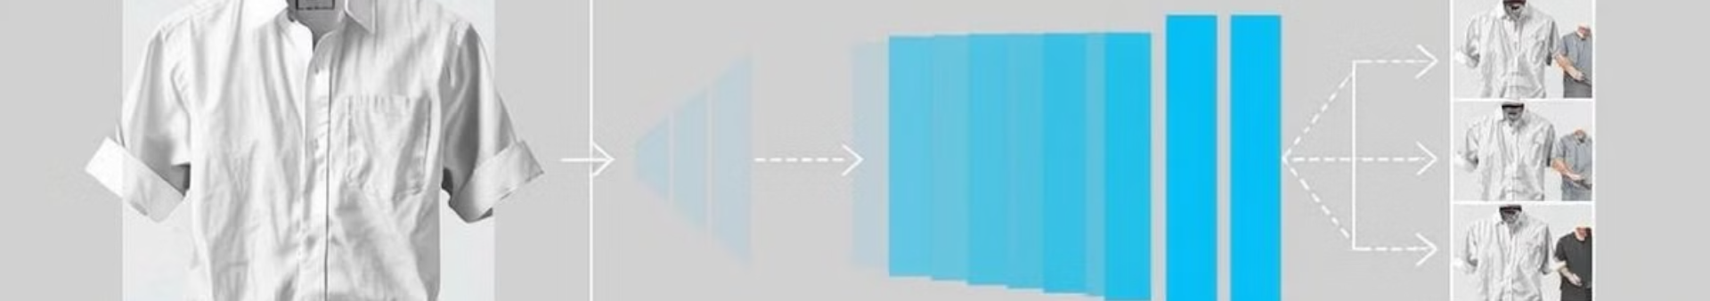




Feature Extraction: Process of Generating Image Embeddings
1. Image Input: Pass a clothing image through the pre-trained model.
2. Convolutional Layers: Image is processed by multiple convolutional layers to extract features, like edges, textures, and shapes.
3. Pooling Layers: Reduce the spatial dimensions of the feature maps, retaining important information.
4. Fully Connected Layers: Combine extracted features into a final representation, the image embedding.

Slide 7
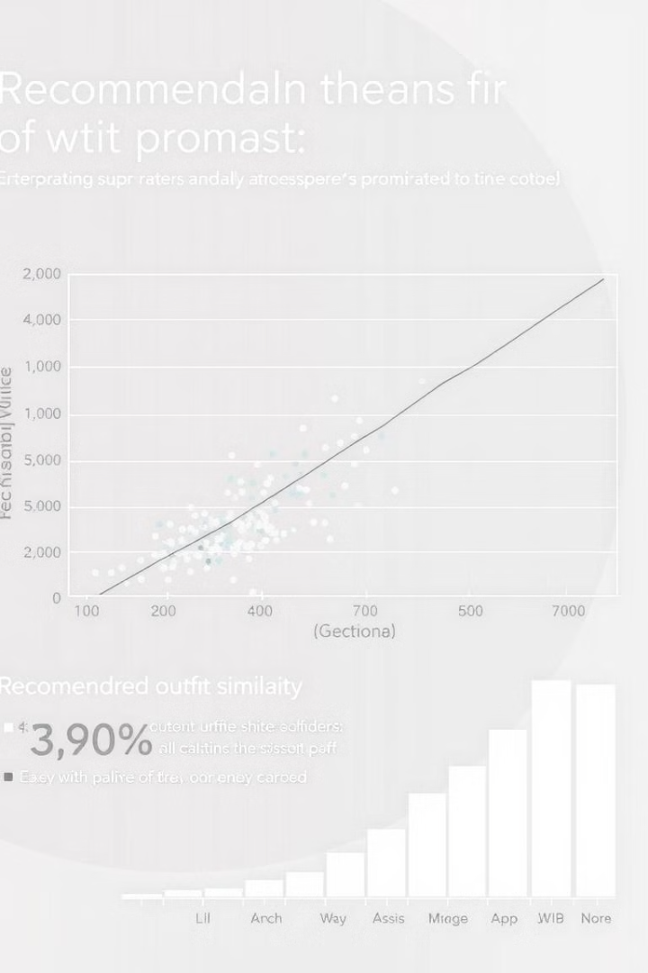
Evaluating Recommendation Accuracy
Cosine Similarity:
Feature Embedding Analysis:
Used to measure the closeness between image embeddings to ensure precise recommendations.
Visual inspection of extracted embeddings to verify meaningful grouping of similar items.
Top-N Accuracy:
Cross-Model Comparison:
Evaluates if the correct recommendations appear within the top results displayed to users.
Results from VGG16, MobileNet, and ResNet are compared to identify the most effective model for accurate predictions.

Slide 8
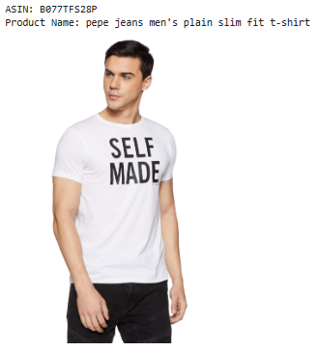
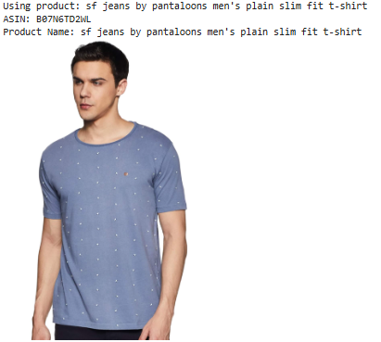
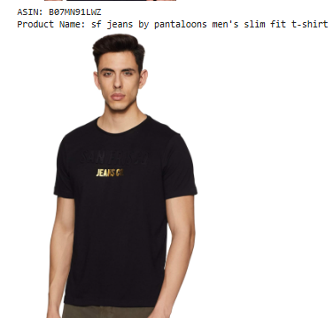
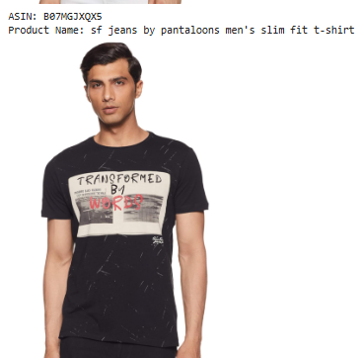
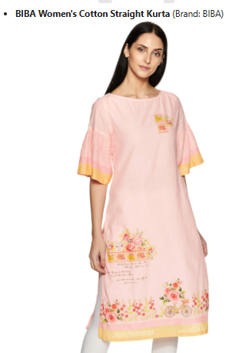
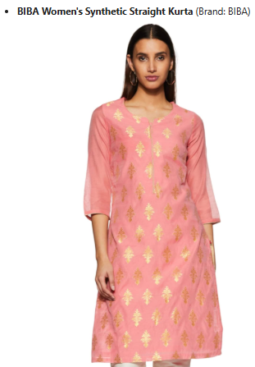
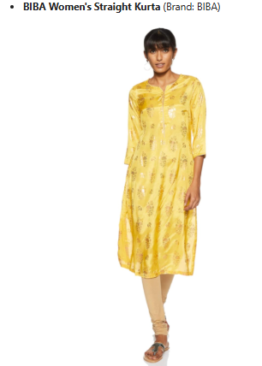
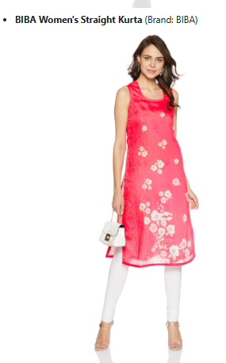
Results: Examples of Recommendations Generated by the System
Recommended based on product names:
Recommended Based on brand

Slide 9
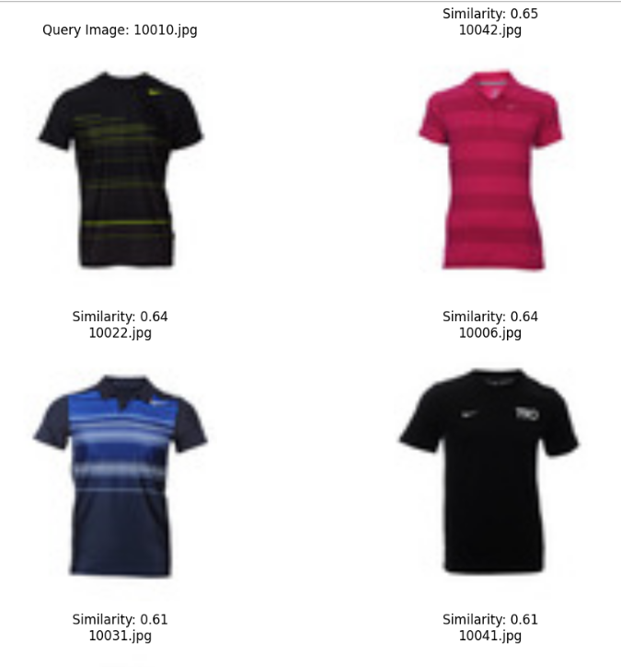
Recommended Based on Similarity of image using cosine similarity

Slide 10
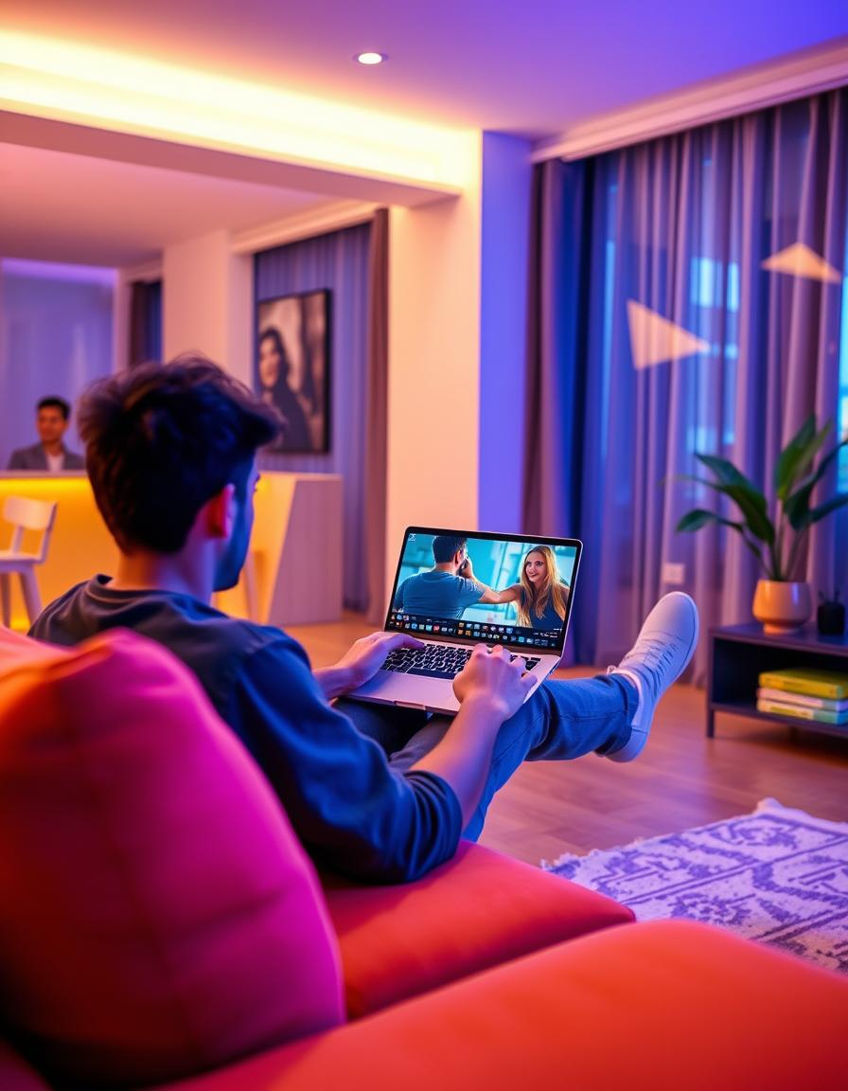
Collaborative Filtering: Personalized Recommendations
Leveraging user preferences and past interactions to create targeted recommendations.
User Similarity:
Identifying users with similar tastes based on their past interactions.
Recommendation Generation
Suggesting items liked by similar users to enhance the user experience.

Slide 11
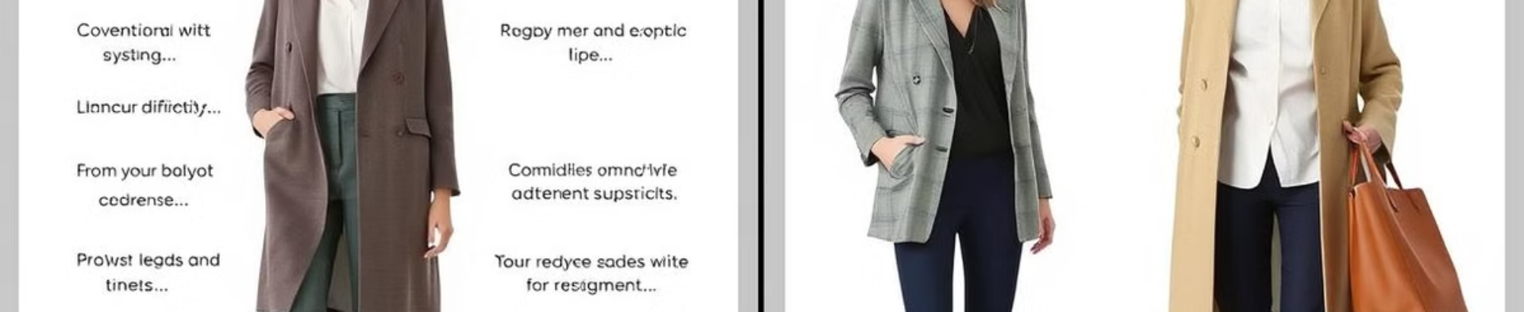
Comparison with Existing Systems
Enhanced Accuracy:
Improved User Experience:
The developed system leverages pre-trained deep learning models, providing more precise recommendations by analyzing visual features, surpassing the limitations of traditional text or metadata-based systems.
By offering visually similar outfit recommendations, the system delivers a more intuitive and engaging shopping experience compared to existing systems relying on basic filtering or manual tagging.

Slide 12
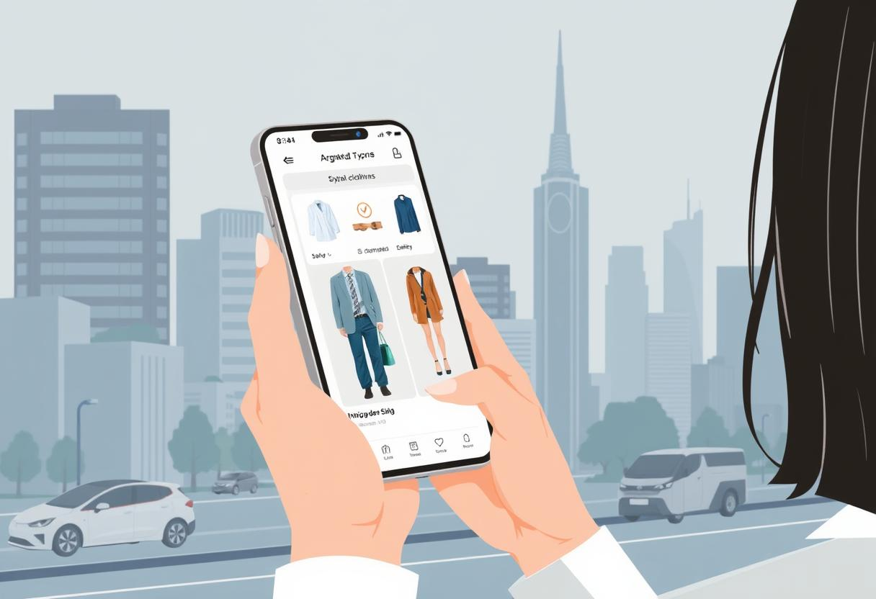
Using time-series analysis to predict future fashion trends.
Using time-series analysis to predict future fashion trends.
Future Scope
Real-Time Recommendations
Optimizing the system to provide instant recommendations during online shopping.
Deploying cloud-based solutions for faster processing and scalability.
Trend Prediction
Using time-series analysis to predict future fashion trends.
Helping brands stock trending items based on customer preferences.

Slide 13
Thank You

